Slide 1
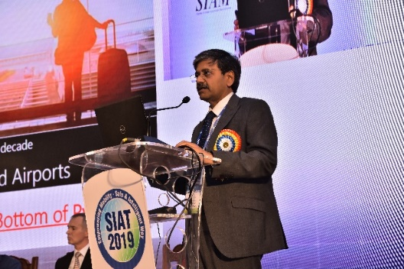
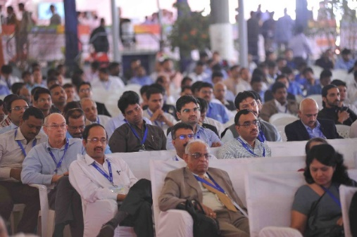
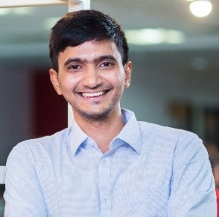
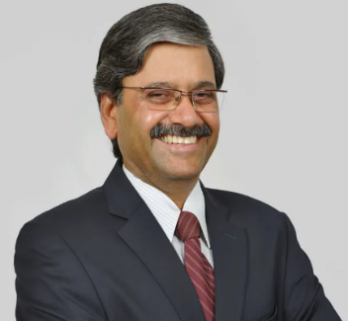
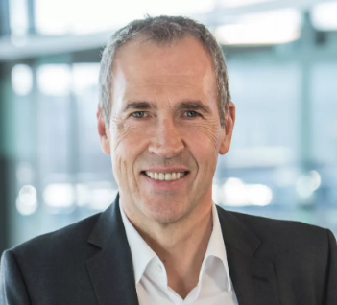
SIAT 2024 PLENARY SESSION-1
Sustainable Technologies for Next Decade
Speakers
Mr. Gustav Tuschen
Executive Vice President
AVL List GmbH
Mr. Swapnil Jain
Co-Founder & Chief Technology Officer
Ather Energy
Mr. C V Raman
Chief Technology Officer
Maruti Suzuki India Limited
Notes:
Plenary session on day-1 will be on topic “sustainable technologies for next decade” Eminent speakers from Maruti, Ather, AVL Germany will be deliver their talk.
Deliberation will initiate transformation towards NetZero emission.

Slide 2
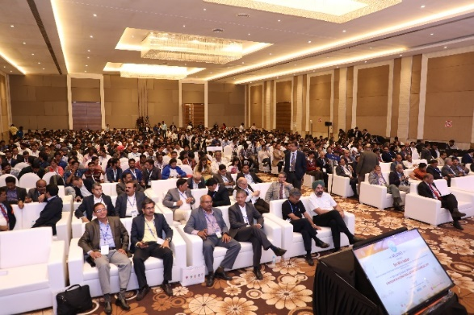
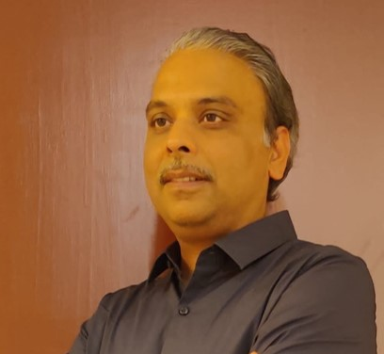
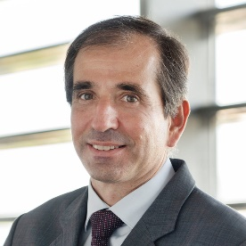
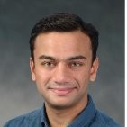
SIAT 2024 PLENARY SESSION-2
Safe Mobility
Speakers
Mr. Naresh Kulkarni
Head of Passive Safety, CFD & CAE
Mercedes-Benz R&D India
Mr. Gonçal Tejera
Head of Passive Safety
Applus+IDIADA
Dr. Kanakasabapathi Subramanian
Senior Vice President
Ashok Leyland Ltd.
Notes:
Topic for Day-2 is “Safe mobility”. Domain experts from Applus+IDIADA, Mercedes-Benz, Ashok Leyland will deliver their presentation.
Presentation will be on ADAS, Crash avoidance and Passive safety features to initiate transformation towards zero fatalities.

Slide 3
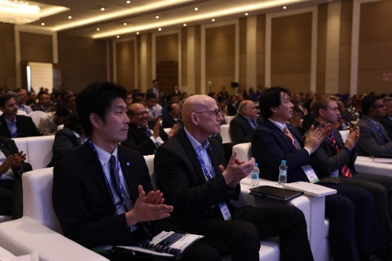
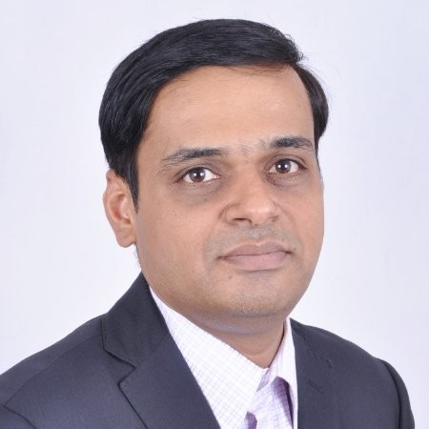
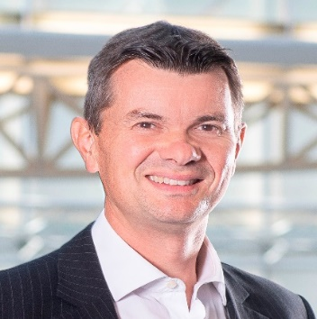
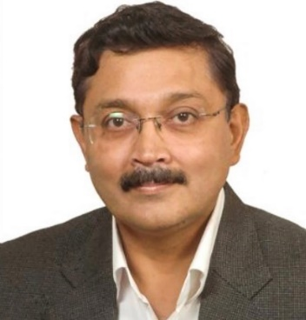
SIAT 2024 PLENARY SESSION-3
Solutions for Future Mobility
Speakers
Mr. Anand Bhange
Director
FEV.io
Dr. Kai Frederik ZASTROW
Senior Fellow
Regulation Certification Standards
Stellantis
Mr. JSR Kutti
Vice President and Chief Sustainability Officer
Tata Motors Ltd.
Notes:
Last and third day the deliberations will on “Solutions for future mobility”. Speakers from FEV, Stellantis, Tata Motors will deliver their talk.
Presentation will cover futuristic topics like software delivered vehicles, cyber security and advance material requirements for light Weighting.

Slide 4
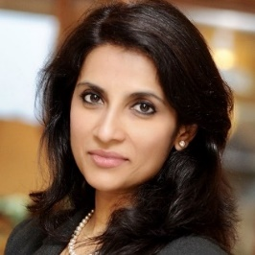

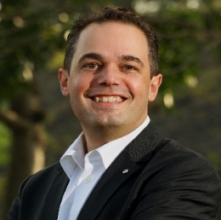
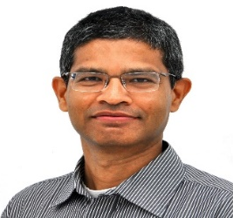
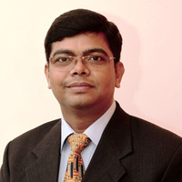
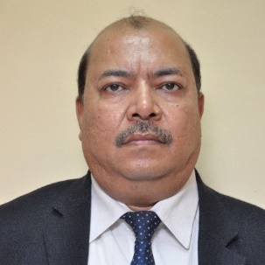
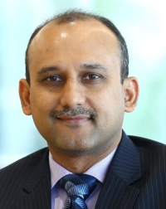
SIAT 2024 PANEL DISCUSSION
Transformation Towards Progressive Mobility
Ms. Sulajja Firodia Motwani
Founder & CEO
Kinetic Green Energy &
Power Solutions Limited
Dr. Reji Mathai
Director, ARAI
Dr. Marc Stehlin
Head - Technology Center
Skoda Auto Volkswagen India Pvt. Ltd.
Dr. N Sarvanan
President &
Chief Technolgy Officer
Ashok Leyland Ltd.
Mr Sanjay Parashar
Executive Director(Supplies)
Indian Oil Corporation Ltd.
Dr. Tapan Sahoo
Executive Director (R&D)
Maruti Suzuki India Ltd.
Mr. Kavan Mukhtyar
Partner, India Automotive Leader
PwC India
Moderator
Notes:
Representatives from Kinetic Green Energy, Ashok Leyland, Indian Oil Corporation, Skoda Auto Volkswagen and Maruti Suzuki along with Director-ARAI will participate in Panel Discussion. Moderator for this will be representative from PwC India. Panel will deliberation future challenges in mobility sector and counter measures through transformative ideas and strategies.

